Slide 1
CLASS 15, 16
Dated 17 and 19th March , 2025
Course Title: 5G and Wireless Technology
Course Code : ECE829
MODULE 3 of the Syllabus:-
From O-RAN to B-RAN with AI automation and Blockchain security
Case study of B-RAN with AI automation
and Blockchain security
*O-RAN … OPEN RADIO ACCESS NETWORK
**B-RAN … Blockchain-enabled RAN
Prof.(Dr.) Rabindranath Bera (Professor, IIIT, KALYANI)
E-mail: rbera@iiitkalyani.ac.in; Mobile : 9475513358
i

Slide 2
Outline of Presentation
COMPARE THREE B-RAN CASE STUDIES :
B-RAN CASE STUDY 1 (5G NIB uses for wireless connectivity in the Server Side):
‘ A Blockchain-Based Secure Data Aggregation Strategy Using Sixth Generation Enabled Network-in-Box for Industrial Applications’
B-RAN CASE STUDY 2 (‘B-RAN ’realization and DEMO’ using 5G Use Case Lab at IIIT ,Kalyani):
‘ A Blockchain-Based Secure Data Aggregation Strategy Using 5G_NIB for Industrial IoT (IIoT) Applications’ [ It would be our 5G Hackathon Proposal to be sent within 15 April ]
B-RAN CASE STUDY 3 : ‘B-RAN ’ realization and DEMO ’ by Hyperledger Foundation
‘Blockchain-enabled Network Sharing for O-RAN’
Video link: https://www.youtube.com/watch?v=1W3j0IA78fk

Slide 3
Outline of Presentation
COMPARE THREE B-RAN CASE STUDIES :
B-RAN CASE STUDY 1 (5G NIB uses for wireless connectivity in the Server Side):
‘ A Blockchain-Based Secure Data Aggregation Strategy Using Sixth Generation Enabled Network-in-Box for Industrial Applications’
B-RAN CASE STUDY 2 (‘B-RAN ’realization and DEMO’ using 5G Use Case Lab at IIIT ,Kalyani):
‘ A Blockchain-Based Secure Data Aggregation Strategy Using 5G_NIB for Industrial IoT (IIoT) Applications’
B-RAN CASE STUDY 3 : ‘B-RAN ’ realization and DEMO ’ by Hyperledger Foundation
‘Blockchain-enabled Network Sharing for O-RAN’
Video link: https://www.youtube.com/watch?v=1W3j0IA78fk

Slide 4
B-RAN CASE STUDY 1:- H. Lin, S. Garg, J. Hu, G. Kaddoum, M. Peng and M. S. Hossain, "A Blockchain-Based Secure Data Aggregation Strategy Using Sixth Generation Enabled Network-in-Box for Industrial Applications," in IEEE Transactions on Industrial Informatics, vol. 17, no. 10, pp. 7204-7212, Oct. 2021, doi: 10.1109/TII.2020.3035006.
Abstract: Sixth generation (6G) network is a revolutionary technology to satisfy the ever-growing demands from the sustainable development of emerging industrial applications and services. Due to its high flexibility, convenient and rapid deployment, self-organization capability, and outstanding expansibility, network-in-box (NIB) represents a promising approach for future networks. The integration of NIB with 6G can lead to many new applications in geoscience, robotics, and industrial automation. For 6G-enabled NIB, services are deployed directly on the NIB, which increases the fault tolerance and reduces the traffic volume on the backhaul link. As more and more data are processed and shared in industrial applications and services, the security of data aggregation becomes a key challenge for 6G-enabled NIB. To address this challenge, in this article, we propose a blockchain based privacy-aware distributed collection (BPDC) oriented strategy for data aggregation. In BPDC, an improved blockchain with a new block header structure and two different block generation rules are designed and introduced, which restricts the task receivers to search and receive the tasks beyond their levels of security permission. While guaranteeing the data aggregation performance, BPDC can also achieve privacy protection by decomposing sensitive tasks and task receivers into multiple groups. Validation experiments show that the BPDC accomplishes low overhead, high throughput, and privacy preservation in various industrial applications.
URL: https://ieeexplore.ieee.org/stamp/stamp.jsp?tp=&arnumber=9246283&isnumber=9480159

Slide 5
I. INTRODUCTION
FIFTH generation (5G) network provides a high standard infrastructure and advanced technologies to enable a variety of industrial applications and services [1]. However, the number of various industrial smart devices and the data traffic are both exponentially increasing each year, which puts pressures on the 5G network and makes it unable to meet the increasing demands of the future industrial applications and services
To solve these problems, sixth generation (6G) network, as a new architecture incorporating disruptive technologies, has attracted wide attention of both the industry and academia.
Compared to 5G network, 6G needs to be more flexible, adaptive, and intelligent for future industrial applications and services solutions [3]. Meanwhile, with its characteristics of high flexibility, convenient and
rapid deployment, self-organization capability, and outstanding expansibility, Network in Box (NIB) becomes a cornerstone of building 6G network [4]. The integration of NIB with 6G results in new applications for geoscience, bioengineering, robotics and various industrial automation. The architecture of 6G-enabled NIB is shown in Fig. 1.

Slide 6
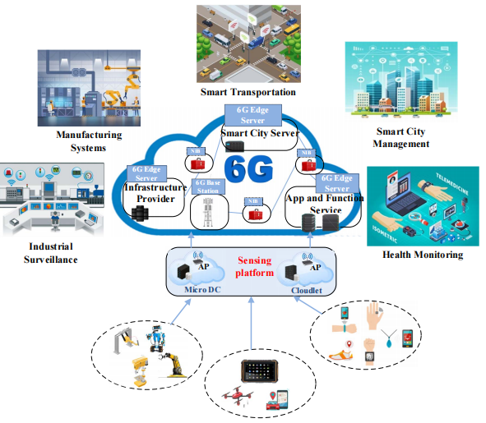
GATEWAY
Fig. 1. Architecture of 6G-enabled NIB

Slide 7
In 6G-enabled NIB, as shown in Fig. 1, there contains three parts located at different layers, namely,
Layer 1:- the sensing platform consisting of many industrial intelligent terminals,
Layer 2:- the edge network composed of NIBs and 6G edge servers, and
Layer 3:- the industrial application platform supporting various industrial application services.
Specifically, the sensing platform is responsible for releasing the industrial application sensing tasks to the industrial intelligent terminals to collect various data and then transmit the data to the edge network.
The NIBs and 6G edge servers located in edge network are employed to aggregate and analyze the data submitted by sensing platform to obtain useful and valuable information. To overcome the disadvantages of using a remote server, most of the 6G-enabled NIB based industrial applications are deployed on the edge NIB, which increases the fault tolerance, reduces the latency and traffic on the backhaul link. Furthermore, the industrial application platforms responsible for receiving data uploaded from the edge network, providing large-scale data storage and further data processing for industrial application service. The applications in 6G-enabled NIB are promising in environmental protection [5], smart healthcare [6], smart city [7], and social survey [8]. To implement the above applications, data aggregation is the premise and foundation, which can extract more useful and valuable information from the raw sensing data.
However, since a great amount of private data are generated, and the data aggregation servers (e.g. NIBs) might be untrustworthy, the service providers (i.e. task releasers) and data providers (i.e. task receivers) may suffer from privacy leakage during the data aggregation process, which becomes a major obstacle to implementing large-scale deployment of 6G-enabled NIB applications.
Thus, as an essential factor for its success, the privacy security in the process of the data aggregation in 6G-enabled NIB must be ensured. Note that the terms “service providers” and “task releasers” used throughout this paper are interchangeable as the terms “data providers” and “task receivers”

Slide 8
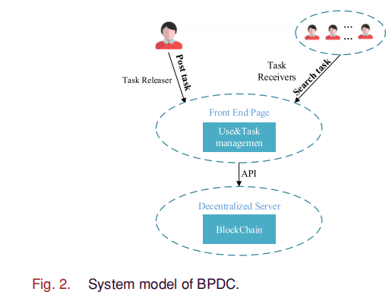

Slide 9
A. System Model: The BPDC system designed based on the traditional employment-based system [23] is shown in Fig. 2, which mainly includes two entities, i.e., tasks receivers and task releasers. In BPDC, the task releasers post the task through the front-end page, and the front-end page posts the task to the blockchain by invoking the application programming interface (API). The task receivers search for tasks through the front-end page and search for tasks whose reputations reach the requirements of the tasks’ security levels. If the task receiver’s reputation cannot meet the security level requirements of the
task, he will be denied for searching the task and obtaining the information of the task. Task receivers are required to pay a certain deposit before accepting the task and finally return the deposit according to the completion of the task

Slide 10
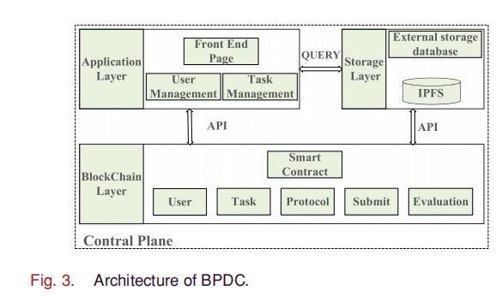

Slide 11
The architecture of BPDC is shown in Fig. 3. Inspired by [24], the BPDC is divided into three layers: 1) application layer, 2) blockchain layer, and 3) storage layer. In this paper, we focus on the application layer and the blockchain layer, and the storage layer we used is the interplanetary file system (IPFS) [25]. The blockchain layer is responsible for recording tasks posted by task releasers to the blockchain and to overcome the single point of failure problem. When a task releaser publishes a task, the smart contract TaskContract is activated by BPDC to record the task information, and, at the same time, the task will be packaged into a block as a transaction and stored on the blockchain. The application layer is responsible for achieving user management and task management and also for providing the front-end page for the task releasers to post the task to the blockchain by invoking the API interface and for the task receivers to search
for tasks.

Slide 12
Outline of Presentation
COMPARE THREE B-RAN CASE STUDIES :
B-RAN CASE STUDY 1 (5G NIB uses for wireless connectivity in the Server Side):
‘ A Blockchain-Based Secure Data Aggregation Strategy Using Sixth Generation Enabled Network-in-Box for Industrial Applications’
B-RAN CASE STUDY 2 (‘B-RAN ’realization and DEMO’ using 5G Use Case Lab at IIIT ,Kalyani):
‘ A Blockchain-Based Secure Data Aggregation Strategy Using 5G_NIB for Industrial IoT (IIoT) Applications’
B-RAN CASE STUDY 3 : ‘B-RAN ’ realization and DEMO ’ by Hyperledger Foundation
‘Blockchain-enabled Network Sharing for O-RAN’
Video link: https://www.youtube.com/watch?v=1W3j0IA78fk

Slide 15
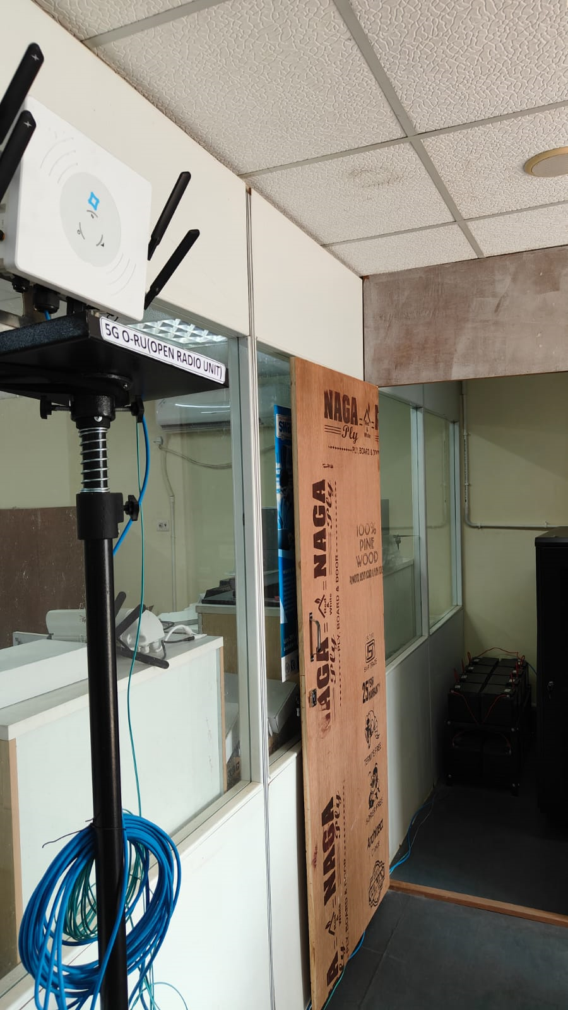
5G O-RAN BASE STATION at IIIT KALYANI
with RADIO UNIT ( RU)
IOT GAteway and IOT Development Board and Sensors at Ground Floor of IIIT KALYANI

Slide 16
Industrial IoT ( I IOT) Gateway and Development Platform at IIIT, KALYANI

Slide 17
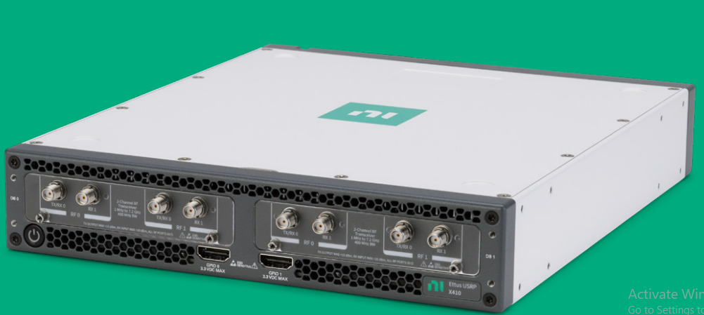
NI Ettus USRP
Software Defined Radios
NI Ettus Research SDR Hardware
From DC to 7.2 GHz, up to 1.6 GHz of real-time bandwidth, powerful DSP-focused FPGAs, and form factors ranging from handheld devices to high-channel-count systems, NI SDRs can meet your needs from design to deployment.
NI Ettus USRP X440
The latest in performance in the X4 Series lineup, USRP X440
contains a Zynq UltraScale+ RFSoC, 8x8 MIMO, and up to 1.6GHz per channel of bandwidth. It supports open-source software only.

Slide 18
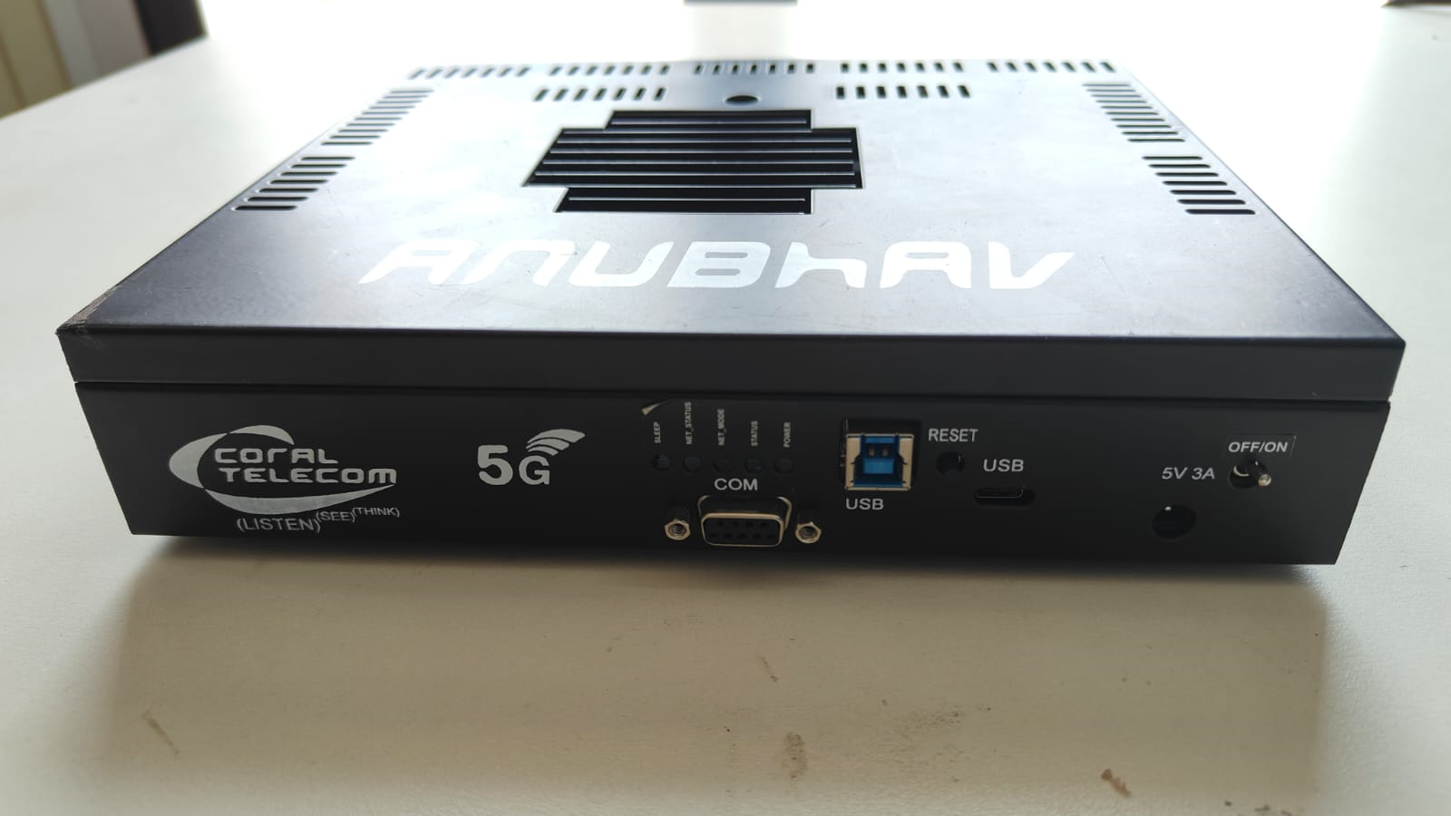
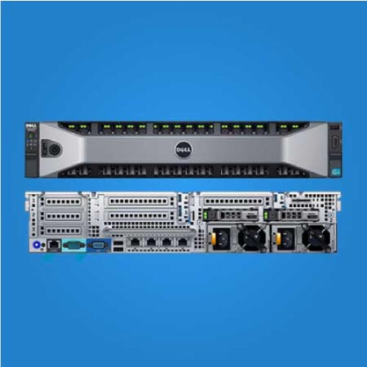
5G NIB development at IIIT, KALYANI using ‘5G EVAL BOARD’ ....or EQUIVALENT 5G SDR ( Software Defined Radio) BOARD
5G EVAL BOARD at IIIT, KALYANI
for 1st , 2nd and 3rd Floor
Dell PowerEdge R730 Server

Slide 19
5G NIB development at IIIT, KALYANI using ‘5G EVAL BOARD’ ....or EQUIVALENT 5G SDR ( Software Defined Radio) BOARD
5G EVAL BOARD at IIIT, KALYANI
for 1st , 2nd and 3rd Floor
National Instrument SDR

Slide 20
Outline of Presentation
COMPARE THREE B-RAN CASE STUDIES :
B-RAN CASE STUDY 1 (5G NIB uses for wireless connectivity in the Server Side):
‘ A Blockchain-Based Secure Data Aggregation Strategy Using Sixth Generation Enabled Network-in-Box for Industrial Applications’
B-RAN CASE STUDY 2 (‘B-RAN ’realization and DEMO’ using 5G Use Case Lab at IIIT ,Kalyani):
‘ A Blockchain-Based Secure Data Aggregation Strategy Using 5G_NIB for Industrial IoT (IIoT) Applications’
B-RAN CASE STUDY 3 : ‘B-RAN ’ realization and DEMO ’ by Hyperledger Foundation
‘Blockchain-enabled Network Sharing for O-RAN’
Video link: https://www.youtube.com/watch?v=1W3j0IA78fk

Slide 21
B-RAN CASE STUDY 2 : ‘Blockchain-enabled Network Sharing for O-RAN’ simulated by HyperLedger Foundation
Lorenza Giupponi and Francesc Wilhelmi
Abstract—The innovation provided by network virtualization in 5G, together with standardization and openness boosted by the Open Radio Access Network (O-RAN) Alliance, has paved the way to a collaborative future in cellular systems, driven by flexible network sharing. Such advents are expected to attract new players like content providers and verticals, increasing competitiveness in the telecom market. However, scalability and trust issues are expected to arise, given the criticality of ownership traceability and resource exchanging in an open RAN sharing ecosystem. To address that, we propose the integration of Blockchain (BC) technology for enabling mobile operators (OPs) and other players to exchange RAN resources (e.g., infrastructure, spectrum usage) in the form of virtual network functions (VNF) autonomously and dynamically. BC will provide automation, robustness, trustworthiness, and reliability to mobile networks, so that confidence is generated in an open RAN environment. In particular, we define a novel O-RAN based BC-enabled architecture that allows automating RAN sharing procedures through either auction or marketplace-based mechanisms. The potential advantages of the proposed solution are demonstrated through simulation results. The used simulation platform is openly released.

Slide 23
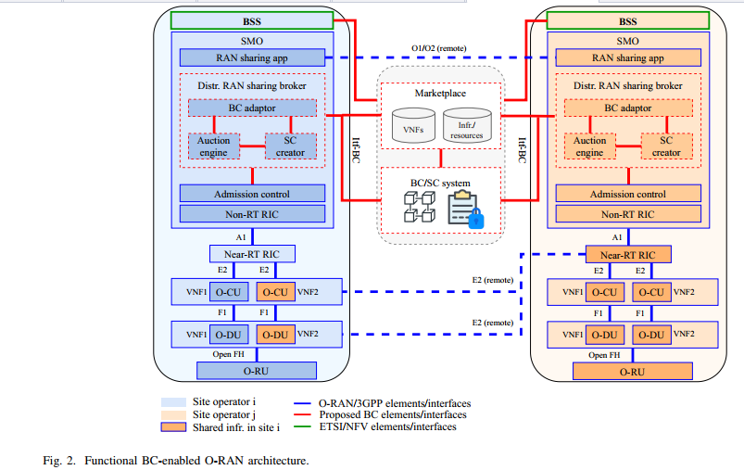

Slide 24
Fig. . Flow diagram of the BC-enabled O-RAN functional architecture, for marketplace case

Slide 25
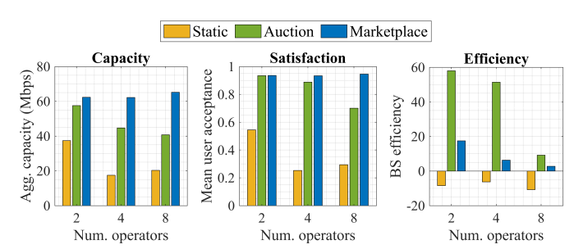
Fig. . UE performance and efficiency of the different BC-enabled RAN sharing mechansism compared to the static situation.

